Slide 1
Beyond Vaccines The Moral Calculus of Fetal Tissue Research
Children of God for Life, Inc.
Stacy Trasancos, Ph.D.
Jose Trasancos, Ph.D.

Slide 2
Remote Licit Cooperation in Evil
Cooperation
X
Passive or Active?
Formal
(intentional)
Material
(unintentional)
X
BUT! We have a “grave responsibility”!
Immediate
(direct)
Mediate
(indirect)
Proximate
X
Abortion, Research, Development
Manufacturing, Marketing
Doctors, Parents
Proximate
Remote

Slide 3
2005 Ethical Guidelines
There is a grave responsibility to use alternative vaccines and to make a conscientious objection with regard to those which have moral problems;
as regards the vaccines without an alternative, the need to contest so that others may be prepared must be reaffirmed, as should be the lawfulness of using the former in the meantime insomuch as is necessary in order to avoid a serious risk not only for one's own children but also, and perhaps more specifically, for the health conditions of the population as a whole...
the lawfulness of the use of these vaccines should not be misinterpreted as declaration of the lawfulness of their production, marketing and use, but is to be understood as being a passive material cooperation and, in its mildest and remotest sense, also active, morally justified as an extrema ratio due to the necessity to provide for the good of one's children...
such cooperation occurs in a context of moral coercion of the conscience of parents, who are forced to choose to act against their conscience or otherwise, to put the health of their children and of the population as a whole at risk. This is an unjust alternative choice, which must be eliminated as soon as possible.

Slide 4
Cooperation in Evil and Scandal
“All of this gives rise to various ethical problems with regard to cooperation in evil and with regard to scandal.”
“Furthermore, the moral requirements must be safeguarded that there be no complicity in deliberate abortion and that the risk of scandal be avoided.”
“In reality, the duty to avoid cooperation in evil and scandal relates to their ordinary professional activities, which they must pursue in a just manner and by means of which they must give witness to the value of life by their opposition to gravely unjust laws.”
Dignitas personae (2008), 34-35 and Donum vitae (1987), 83

Slide 5
Definition of scandal
“Scandal is therefore fittingly described as something done less rightly, so as to comprise both whatever is sinful in itself, and all that has an appearance of evil.” STII-II.43.1 and 1 Thess 5:22
“…if a man were to sit at meat in the idol’s temple (1 Cor 8:10), though this is not sinful in itself, provided it be done with no evil intention, yet, since it has a certain appearance of evil, and a semblance of worshipping the idol, it might occasion another man’s spiritual downfall.”

Slide 6
Aborted Children in Biomedical Research - THEN
Cited in scientific literature as early as 1930s.
Development of polio vaccine (1930-70s)
Abortions were hysterotomies on the “feeble-minded”
Babies dissected “while still alive”
Development of infant formula (1970-90s)
Abortions were hysterotomies of mothers in good health
Amino acids injected into umbilical cord while still alive
Hearts still beating and babies were moving
Since Roe v. Wade, it has been considered “ethical” to use the bodies.
~50 million specimen
More ethical to use bodies than waste them
Immoral not to use aborted children for research and save lives
Resources:
Forsaking God for the Sake of Science, Children of God for Life
The Cultivation of the Poliomyelitis Viruses in Tissue Culture, Enders, et al, Reviews of Infectious Diseases
Milestones in Early Poliomyelitis Research (1840 to 1949), Eggers, et al, Journal of Virology
Development of Mammalian Sulfur Metabolism: Absence of Cystathionase in Human Fetal Tissues, Raiha, et al, Pediatric Research
The Ethics of Fetal Research, Paul Ramsey
Reproduction, Ethics, and the Law: Feminist Perspectives, Joan C. Callahan

Slide 7
Aborted Children in Biomedical Research – Then/NOW
Aborted Fetal Cell Lines
HEK-293: Human Embryonic Kidney, Specimen No. 293
Abortion performed in Netherlands
Kidney Tissue; Gestation age not recorded
PER.C6
Abortion in Netherlands, “mother wanted to get rid of the fetus, father unknown” 16-18 weeks gestation
Retinal tissue
COVID-19 Vaccines

Slide 8
Aborted Children in Biomedical Research - NOW
Scalps of Aborted Children Grafted onto Rodents
September of 2020
University of Pittsburgh
Humanized mice and rats with “full-thickness human skin”
Scalps from aborted children 18-20 weeks
Same child’s lymphoid tissues and hematopoietic stem cells from the liver
Study of infection-induced immunopathogenesis through skin infection.
Y. Agarwal et al., “Development of humanized mouse and rat models with full-thickness human skin and autologous immune cells,” Scientific Reports Vol. 10, 14598 (September 3, 2020), doi: 10.1038/s41598-020-71548-z.

Slide 9
Aborted Children in Biomedical Research - NOW
J. Cao et al., “A HUMAN CELL ATLAS of fetal gene expression,” Science Vol. 370, Issue 6518 (November 13, 2020), doi: 10.1126/science.aba7721.

Slide 10
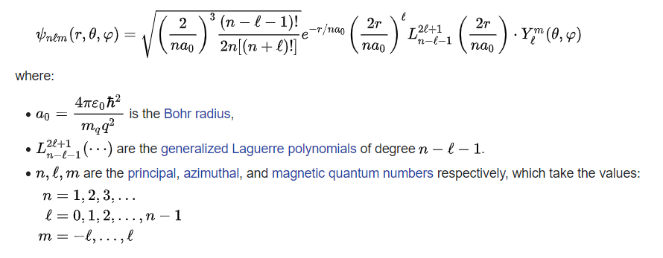
Moral Quantum Calculus (Study of Continuous change)

Slide 11
Moral Calculus (Study of Continuous change)
Abortion
Human Value
Protecting Ourselves
Protecting Communities
Scientific Knowledge
Medical Knowledge
Influencing Sin
Benefiting from Evil
Ethical Concession
Eternal Life
Do I get the jab?

Slide 12
Moral Arguments
Vaccines and Doubly Remote Cooperation in Evil (November 22, 2020 by Matthew P. Schneider, LC)
Neither the Pfizer nor the Moderna vaccine poses any significant moral concern. Any moral issues with both are so remote and minor that they should prevent nobody from getting either of them.
Covid Vaccines: ‘The Ends Cannot Justify the Means’ (December 11, 2020 by Bishop Athanasius Schneider)
The Morality of the COVID-19 Vaccines (December 24, 2020 by Janet E. Smith)
If morally unproblematic alternatives were available, one should refuse anything produced or tested using cell lines made from aborted fetuses for the sake of honoring the inherent dignity of the aborted victim. The question remains, is it always and everywhere wrong for a person, to avail themselves of this benefit if no alternatives are available?
The COVID Vaccines Are Not “Morally Compromised” (January 4, 2021 by Melissa Moschella)
The use of HEK 293 or similar cell lines in no way perpetuates the grave injustice of abortion or implies approval of abortion. To call a cell line, a vaccine, a railroad, a medication, or any other physical thing morally compromised is simply a category mistake, because good and evil are characteristics of the human will, not of physical things.
If Any Drug Tested on HEK-293 Is Immoral, Goodbye Modern Medicine (January 28, 2021 by Schneider, LC)

Slide 13
Accept without accepting
Do we take the vaccine?
Do we accept the vaccine?
Do we accept the practice of using aborted children?
How do we not be hypocritical?
How do we right the wrong?
How do we lead change?
How do we fight for our humanity?

